Slide 1

Working With Data DATA9910
Lucas Rizzo
email: lucas.rizzo@tudublin.ie

Slide 2
About me
TU Dublin lecturer since 2020.
MSc coordinator. Any questions about dissertation proposals give me a shout or check the MSc dissertation website.
I’m from Belo Horizonte - Brazil and I have been living in Dublin since 2015.
My research focus is on Artificial Intelligence, more specifically automated reasoning and computational models of argument.
If you are interested in these topics you can have a look at my website.

Slide 3
Lectures
Full-time programme TU059
Mondays 16:00-18:00
Wednesdays 11:00-13:00
All classes and labs onsite (unless otherwise stated)
Part-time programme TU060 and
Data Science Certificate TU256
Thursdays 18:00-22:00
Onsite CQ007 (and mirror online) Week 1, Week 6, and Week 13
Online classes, Week 2-5, Week 7-12

Slide 4
Communication statement
Outside class hours, we should communicate primarily through email: lucas.rizzo@tudublin.ie
You can send me emails any time, and it should be answered in 1 or 2 days maximum.
Pay attention to emails and announcements for this module in Brightspace! That is how I will let you know about updates or any recent changes in the module.

Slide 5
Online material
Materials available through Brightspace
Search for Working with Data DATA9910
Lecturer Lucas Rizzo
Be sure to enroll in the right programme, TU059 or TU060/256 as in the description of the course.

Slide 6
Reading list
Essential Reading:
Wickam & Grolemund, R for Data Science, O’Reilly Press, 2016. Free at https://r4ds.had.co.nz/
Andrew O. Finley, Jeffrey W. Doser, Vince Melfi, R Programming for Data Sciences. 2020. Free at https://bookdown.org/rdpeng/rprogdatascience/
McKinney, Wes. Python for data analysis: Data wrangling with Pandas, NumPy, and IPython. " O'Reilly Media, Inc.", 2022. Open access HTML https://wesmckinney.com/book/

Slide 7
Reading list
Supplemental Reading:
Bruce, Peter, Andrew Bruce, and Peter Gedeck. Practical statistics for data scientists: 50+ essential concepts using R and Python. O'Reilly Media, 2020
Rafael C. Gonzalez, Richard E. Woods., Digital image processing, Pearson, 2017
Sweigart, Automate the Boring Stuff with Python, No Starch Press, 2019
Beaulieu, Learning SQL, O’Reilly Media, 2020 Hands on Programming with R: free here
Beaulieu, Learning SQL, O’Reilly Media, 2020
(for those who need a detailed introduction to essential concepts in statistics)
(for those interested in getting in-depth knowledge of image data)
(for those unfamiliar with Python)
(for a more practical approach learning R)
(for those unfamiliar with SQL)

Slide 8
Tech Stack
Python |  | R
pandas | requests | devtools | Rraven
matplotlib | scikit-image | warbleR | maps
numpy | os | ggplot2 | tuneR
sqlalchemy | scipy | lattice | seewave
psycopg2-binary |  | readr | signal
sqlalchemy_schemadisplay |  | rvest | audio
pillow |  | DBI | odbc
ipython |  | RPostgres | blob
jupyterlab |  | dplyr | titanic
seaborn |  | dbplyr | rlang
PostgreSQL
Pgadmin4 (GUI)
PostgreSQL server
Notebooks
Jupyter (.ipynb)
R (.rmd)

Slide 9

Datacamp
You can access DataCamp courses for extra practice (that is highly recommended)
Please create an account with the @mytudublin.ie domain to have free access to all courses through the link below
Link to register on DataCamp
Some courses that might help you in the first weeks (not all there is covered in this module): Intro to Python for Data Science Intermediate Python
Introduction to R
Introduction to importing data to R
Web scraping in R

Slide 10
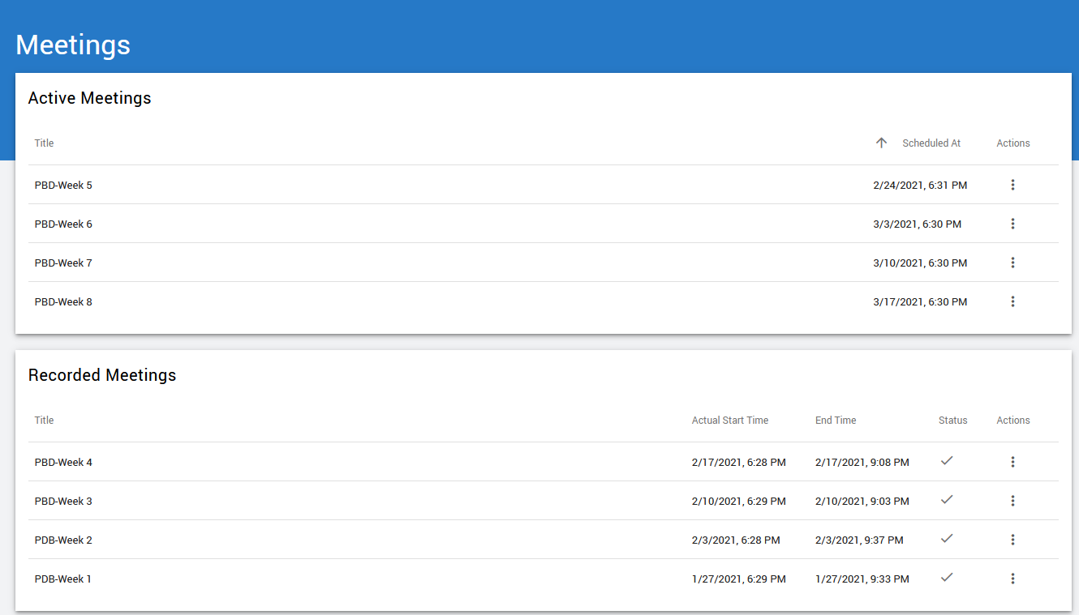
Recordings
Recorded lectures (if recorded) are available in Brightspace.
Go to Module Tools > Virtual Classroom

Slide 11
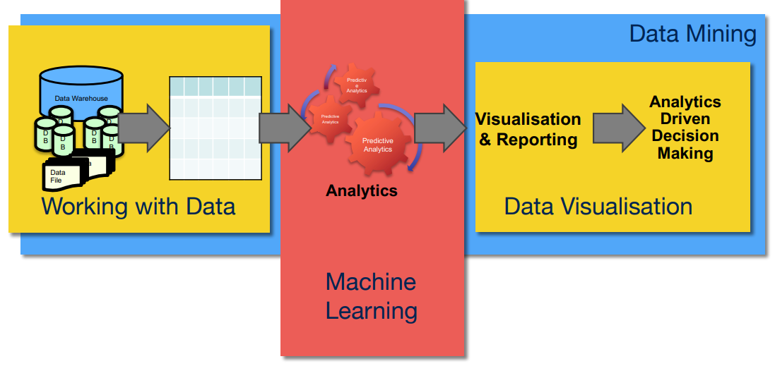
Content
Foundational module for data science

Slide 12
Assessment
Lab assignments (40%). Some labs are marked and will need to be submitted
SQL programming and data centric languages (Python/R) (20%) (Week 5)
Image data lab (10%) (Week 10)
Audio data lab (10%) (Week 11)
Continuous assessment (60%). Week 13
Select a dataset and create a notebook (data collection, cleaning, merging and some visualisation)

Slide 13
Indicative schedule
Week 1 | Set up environment and R notebook
Week 2 | Review Python and practice
Week 3 | Review R Importing data with R
Week 4 | Intro SQL and aggregate queries
Week 5 | Databases and scripting languages (To be submitted)
Week 6 | Interpreting Data (summary statistics, data visualisation)
Week 7 | Review week
Week 8 | Data manipulation in R Pandas and Numpy
Week 9 | Data visualisation in Python Data processing (regular expressions)
Week 10 | Audio data (R and tuneR) (To be submitted)
Week 11 | Image data (Python and skimage) (To be submitted)
Week 12 | Time series (Python and Pandas)
Week 13 | Working on Assignment Assignment deadline

Slide 14
This week Tasks
Download and Set Up R and R-Studio
Download and Set Up Python and Jupyter Notebook (see slides)
Explore the Sample R Notebook File

Slide 15
Questions?

